Slide 1
Trans-Pacific Partnership
Alan V. Deardorff
University of Michigan
Lecture 6
Nankai University
March 3, 2016

Slide 2
What Is the TPP?
Trans-Pacific Partnership:
  “21st-Century” Trade agreement among 12 countries covering 36% of the world economy
Agreed October 5, 2015, after first being mentioned in 2008 and negotiations since 2010.
Now needs to be approved by all 12 countries, including US.
Approval by US House and Senate will be contentious.
Text released November 5, 2015.

Slide 3
What Is the TPP?
Once approved, TPP will be a “living agreement”:
  Open to enlargement, admitting new members if they agree to its rules and negotiate market access with all members.
    Some others already considering it: S. Korea, Indonesia, Philippines.
    Could include China in future.
  Rules will change as needed as circumstances and technologies evolve.

Slide 4
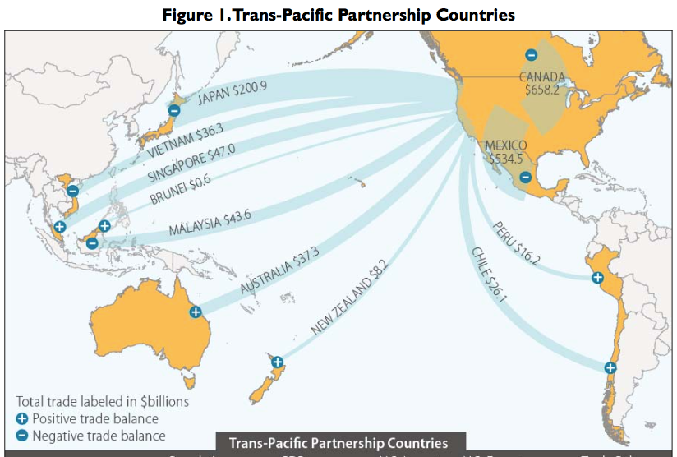

Slide 5
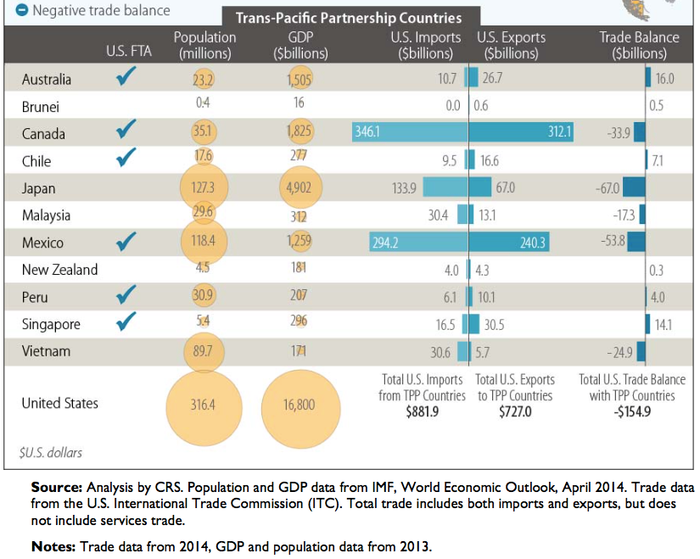

Slide 6
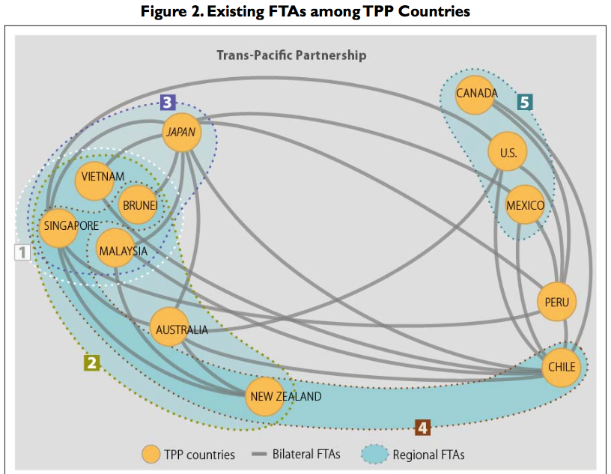

The “Spaghetti Bowl”

Slide 7
What Is the TPP?
Main Features of TPP (only a few of 30 chapters):
  Trade in goods: Reduce/remove tariffs & NTBs
  Trade in services: Reduce/remove barriers
  Digital trade: Facilitate data flows and E-commerce
  Investment: Investor/State Dispute Resolution
  Intellectual Property: Expanded patents, etc.
  Labor: Enforcement of standards
  Environment: Enforcement of standards
  State-Owned Firms: Competitive neutrality

Slide 8
Trade in Goods
Trade in goods: Reduce/remove tariffs & NTBs on 11,000 products among TPP countries
  Most US tariffs (average 3.4%) fall to zero.
  Most tariffs faced by US exports fall to zero:
  Main exception: Certain agriculture
  Other policies and regulations that restrain trade to be harmonized or removed.

Slide 9
Trade in Goods
Tariffs
  Cars and trucks: US tariffs removed
    Cars: 2.5%, removal phased in over 25 years.
    Trucks: 25%, removal phased in over 30 Years.
  Schedules and rates differ by exporting country

Slide 10
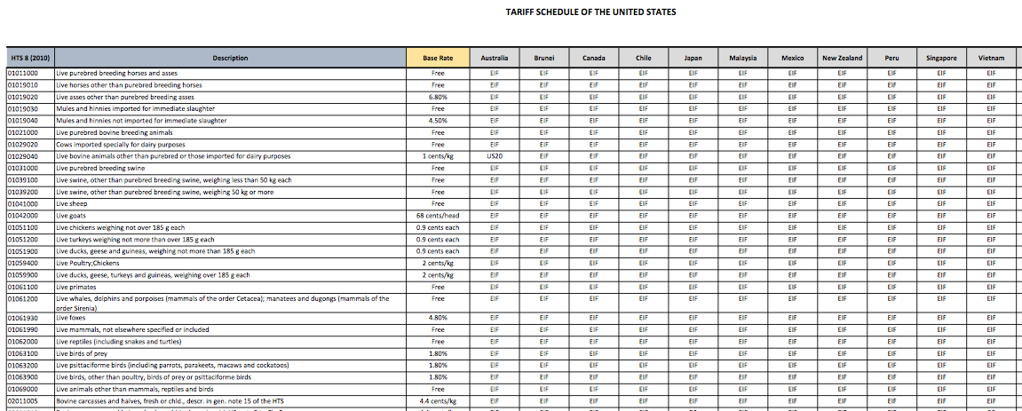

Slide 11
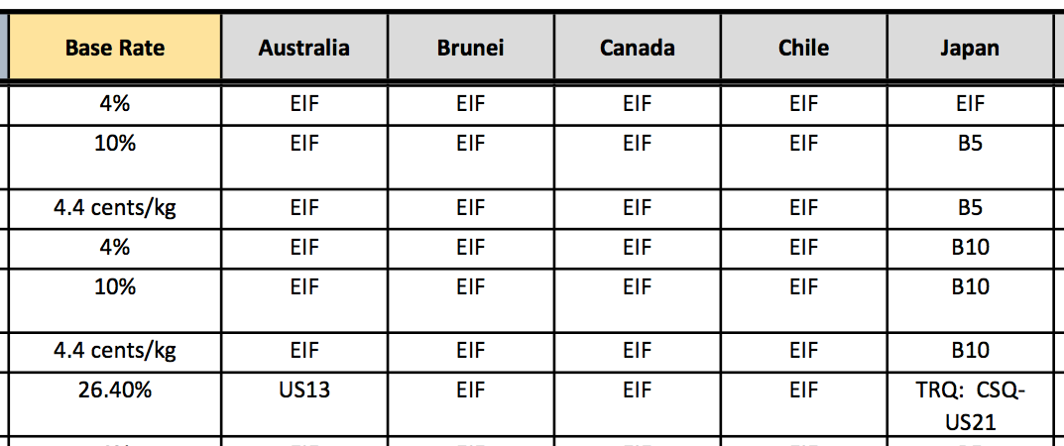
EIF: Entry In Force (duty-free from start)
B10: Eliminated in 10 annual stages, duty-free in year 10
Bovine Meat Cuts (i.e., Beef)
US21: No higher that Peru FTA
US13: Base rate until 2022; duty-free in 2022

Slide 12
Trade in Services
Trade in services: Reduce/remove barriers among TPP countries
  Remove restrictions on service providers (most restrictive in poorer countries).
  Facilitate international movement of persons working temporarily in firms if needed for other aspects of TPP commitments.

Slide 13
Digital Trade
Digital trade: Facilitate data flows and E-commerce
  Bars customs duties on digital products
  Prevents blocking of cross-border data flows
  Prohibits forced localization of data centers
  (Some exceptions permitted.)

Slide 14
Investment
Investment: Investor/State Dispute Resolution
  Right of establishment
  Transfer of payments out of host country
  Investor-State Dispute Settlement (ISDS) to prevent expropriation or “indirect expropriation”
    Allows foreign investors to seek international arbitration to settle disputes with host governments

Slide 15
Intellectual Property
Intellectual Property: Expanded patents, etc.
  Expand IP protection beyond that already covered in the WTO
  Extend copyright protection from 50 to 70 years from death of author
  Criminal penalties for copyright violation and for theft of trade secrets
  Extend period of data exclusivity on some types of medicines, esp. biologics

Slide 16
Labor
Labor: Enforcement of labor standards
  ILO Core Labor Standards (not enforced by ILO)
    Freedom of association and collective bargaining
    Elimination of compulsory or forced labor
    Abolition of child labor
    Elimination of discrimination
  TPP will require countries to enforce these, plus “acceptable conditions of work”
    Minimum wage
    Hours of work
    Occupational safety and health
  Violation will be subject to TPP dispute settlement
Notes:
TPP, p. 19-1

Slide 17
Environment
Environment: Enforcement of standards
  US was pushed to include:
    Enforcement of domestic environmental laws and multilateral agreements
    Prohibition of relaxing rules to encourage trade or investment
    Provisions to combat: wildlife trafficking, illegal logging and fishing, fishing subsidies
    Stakeholder participation
  Much of this is included in TPP, together with mechanisms for enforcement.
Notes:
http://www.nytimes.com/2015/10/06/business/environmentalists-praise-wildlife-measures-in-trans-pacific-trade-pact.html?ref=todayspaper

Slide 18
State-Owned Enterprises
State-Owned Enterprises (SOEs): Achieve “competitive neutrality”
  Addresses commercial disadvantages of private firms competing with SOEs
  Requires transparency and reporting
  Prohibits noncommercial assistance to SOEs that adversely impacts others

Slide 19
Contentious Issues
Several Issues threatened to derail the negotiations and were resolved only at the last minute:
  Biologic Drugs
  Dairy Products
  Auto Parts
  Japanese Agriculture: Rice, Pork and Beef
  ISDS
  Exchange Rates

Slide 20
Contentious Issues: Biologics
Biologic Drugs
    (advanced medicines made from living organisms)
  The issue:
    Time period of permitted data secrecy
  US wanted 12 years of protection, as contained in the Affordable Care Act. Japan also favored long period of protection.
  Australia and others wanted much shorter protection, 5 or 6 years, so as to speed the development of generics and reduce costs.
Notes:
WSJ: http://blogs.wsj.com/briefly/2015/10/05/5-challenges-at-the-trans-pacific-partnership-negotiations/

Slide 21
Contentious Issues: Biologics
Resolution:
  “The compromise set a mandatory minimum of five years, without setting a maximum, leaving both sides to declare victory.” (NYT, Oct 6, 2015)
  US will keep it’s 12-years of protection, but others will not. 5 years protection will be an increase for some countries.
Notes:
WSJ: http://blogs.wsj.com/briefly/2015/10/05/5-challenges-at-the-trans-pacific-partnership-negotiations/

Slide 22
Contentious Issues: Dairy
Dairy Products
  Exporters (New Zealand, U.S.) wanted reduced barriers into protected markets such as Canada and Japan
  New Zealand also wanted increased exports into U.S.
  Canada resisted because of its dairy support program.
Notes:
http://blogs.wsj.com/briefly/2015/10/05/5-challenges-at-the-trans-pacific-partnership-negotiations/

Slide 23
Contentious Issues: Dairy
Resolution:
  Some expanded imports into Canada and US was agreed via
    Expanding tariff-rate quotas
    Some lowered tariffs
Notes:
http://blogs.wsj.com/briefly/2015/10/05/5-challenges-at-the-trans-pacific-partnership-negotiations/

Slide 24
Contentious Issues: Auto Parts
Auto Parts
  Issues are
    Tariffs and other barriers into both US and Japan
      US has 25% tariff on trucks (& only 2.5% on cars)
      Japan has non-tariff barriers
    Rule of Origin for cars and car parts:
      Japan wanted it low, to permit it to include inputs from non-TPP countries such as Thailand and China.
      Mexico wanted it at least 50%, to preserve the advantage over those countries that it has in NAFTA, where it is effectively 53-55%.
Notes:
http://blogs.wsj.com/briefly/2015/10/05/5-challenges-at-the-trans-pacific-partnership-negotiations/
http://www.nytimes.com/2015/10/06/business/international/what-changes-lie-ahead-from-the-trans-pacific-partnership-pact.html?ref=todayspaper

Slide 25
Contentious Issues: Auto Parts
Resolution:
  Long phase-outs of US tariffs: trucks 30 years, cars 25, auto parts up to 15
  45 percent TPP content for cars & light trucks to qualify for preference
Notes:
http://www.nytimes.com/2015/10/06/business/international/what-changes-lie-ahead-from-the-trans-pacific-partnership-pact.html?ref=todayspaper
“United States and Japan agreed to long periods before American tariffs on Japanese vehicles sold in this country are phased out — 30 years for trucks, 25 for autos, and up to 15 years for some auto parts.” (NYT Oct 5, 2015)
“45 percent of the value of each car or light truck will need to be produced in a Trans-Pacific Partnership country for the vehicle to be charged little or no duty by customs officials.” (NYT Oct 5, 2015)

Slide 26
Contentious Issues: Japanese Ag.
Rice, Pork, and Beef
  Japan has had a prohibitive tariff on imports of rice, protecting rice farmers who are important supporters of Japan’s ruling Liberal Democratic Party.
  US and Australia are major exporters of rice and want access into Japan
  Pork and beef are similar to rice but less so: Japan has high tariffs, which the U.S. wants it to reduce.
Notes:
http://blogs.wsj.com/briefly/2015/10/05/5-challenges-at-the-trans-pacific-partnership-negotiations/“45 percent of the value of each car or light truck will need to be produced in a Trans-Pacific Partnership country for the vehicle to be charged little or no duty by customs officials.” (NYT Oct 5, 2015)

Slide 27
Contentious Issues: Japanese Ag.
Resolution:
  Japan will lower its tariff on beef from over 38.5% to 9% over 16 years
  Pork tariff will fall from 4.3% to 2.2%, but will also lower minimum import price from ¥482/kg to ¥125, and later to ¥50.
  Rice: New duty-free quota of 50,000 tons, rising to 75,000 tons in year 13
Notes:
http://blogs.wsj.com/briefly/2015/10/05/5-challenges-at-the-trans-pacific-partnership-negotiations/

Slide 28
Contentious Issues: ISDS
ISDS: Investor-State Dispute Settlement
  This gives multinational firms leverage over governments to resist policies that reduce their profits
  Most objected-to have been actions by tobacco companies that use trade agreements to block cigarette labeling requirements

Slide 29
Contentious Issues: ISDS
Resolution:
  Cigarette companies will not have access to ISDS.
  No other weakening of ISDS

Slide 30
Contentious Issues: Exchange Rates
Exchange Rates
  Many in US wanted TPP to address currency undervaluation (which makes exports cheaper)
    Most other TPP countries opposed this, as did the Obama administration
    Countries often accused of currency manipulation include Japan and China.
Notes:
http://www.nytimes.com/2015/10/06/business/international/what-changes-lie-ahead-from-the-trans-pacific-partnership-pact.html?ref=todayspaper

Slide 31
Contentious Issues: Exchange Rates
Resolution: Side Agreement on Exchange Rates:
  Commitment to avoid manipulation
  Transparency and Reporting
  Group to meet at least annually to discuss macroeconomic and exchange rate issues
  No enforcement mechanism
Notes:
http://www.nytimes.com/2015/10/06/business/international/what-changes-lie-ahead-from-the-trans-pacific-partnership-pact.html?ref=todayspaper

Slide 32
Contentious Issues and Their Resolutions
In each case, there were losers and winners, usually both in each country.
Losers may now oppose the TPP.
Thus support for TPP is reduced, and getting it past US Congress will be problematic.
Notes:
http://www.nytimes.com/2015/10/06/business/international/what-changes-lie-ahead-from-the-trans-pacific-partnership-pact.html?ref=todayspaper

Slide 33
What’s Next?
Congress has 90 days to review the details before Obama can sign.
USITC will have up to 105 days to do a full economic review.
TPP must be approved by the political process in each of the 12 countries, which may be most problematic in the US.
Congress – both houses – will have to accept or reject it by a simple majority up-or-down (no amendments) vote.
  Decisions are unlikely during US presidential campaign.
  May be considered in 2016 after the election.

Slide 34
My focus here:
  Trade effects on neighboring countries
  Many of these have FTAs with each other and/or with the US
  How will TPP enhance or undermine the benefits to them of these arrangements?

Slide 35
How will TPP affect the trade of its Neighbors?
Why this is of interest:
  TPP is large, both geographically and economically
  Trade has effects on neighboring countries
  Many of these have FTAs with each other and/or with the US
  How will TPP enhance or undermine the benefits to them of these arrangements?

Slide 36
Overlap of TPP with ASEAN and other FTAs
TPP overlap
  ASEAN
    Is and FTA itself: AFTA
    Has FTAs with several neighbor countries
  US
    NAFTA (North American Free Trade Area)
    FTAs with several other TPP and non-TPP countries

Slide 38
Overlap of TPP with other FTAs
Messages:
  All these countries are heavily linked to existing FTAs:
    Most are both FTAs and Economic Integration Agreements (EIAs) on services .

Slide 39
Overlap of TPP with other FTAs
The Message:
  TPP should not be understood in the same way that both the original EU and NAFTA were understood, as arrangements among countries that had no other prior arrangements
  TPP is integration between countries that are already heavily integrated with others

Slide 40
Trade Effects of TTIP
I’ll focus mainly on the largest trade flows
  Top-five partners for exports
  Top-five partners for imports

Slide 43
Trade Effects of TPP
Four main effects
  Trade creation: Import from partner what was previously produced at home
  Trade diversion: Import from partner what was previously imported from 3rd country
  Preference erosion: Loss of a preference when a previous partner forms FTA with a 3rd country
  Trade reversion: Import from new partner what had been diverted to a partner in prior FTA

Slide 44
Trade Effects of Individual FTAs
Trade Creation: Import from partner what you previously produced yourself
  Beneficial to partner, which exports
  Beneficial to importing country as a whole
  But harmful to import-competing industry in importing country

Slide 45
Trade Effects of Individual FTAs
Trade Diversion: Import from partner what you previously imported from an outside country
  Harmful to outside country
  Harmless to import-competing industry in importing country (there is none)
  Harmful to importing country as whole, as it pays more for imports
  Beneficial to the partner exporting country

Slide 46
Trade Effects of Additional FTAs
Preference Erosion: Lose preference advantage to previous FTA partner when it forms FTA with your competitor
  Harmful to you and your export industry
  Beneficial that partner, like trade creation
  Beneficial to competitor

Slide 47
Trade Effects of Additional FTAs
Trade Reversion: Undo previous trade diversion
  Beneficial to previous outside country
  Beneficial to importing country, like trade creation
  Harmful to beneficiary of previous trade diversion

Slide 48
B
A
D
C

Slide 49
(Sample Countries)
(US)
B
(Japan)
A
D
(Mexico)
C
(Chile)

Slide 50
Trade Diversion
B
Hurts A & D
Helps C
Hurts B (!)
A
D
C

Slide 51
Trade Effects of FTAs
Additional effect if a member already has an FTA with an outside country:
  Trade reversion: Imports that were diverted from the new partner by the 1st FTA revert to the new partner with the 2nd FTA
  This is a form of trade diversion
    Harmful to the country diverted from (which had benefited from 1st FTA’s trade diversion)
    But beneficial to the importing country – it gets back to cheap imports

Slide 52
B
A
D
C

Slide 53
(TPP)
Trade Reversion
B
Helps A
Hurts C
Helps B
A
D
More Trade Diversion
C
Helps B
Hurts A
Hurts C (&D)

Slide 54
Trade Effects of TPP
In the paper I work through the trade effects on individual countries and groups of countries
Discussion is based on the presence and absence of FTAs in Figure 4 covering the major trade flows indicated in Figures 5 & 6
I’ll do just a sample here

Slide 55
Australia
  Biggest trade partners are
    China – not in TPP
    Japan – in TPP
  Will gain from
    It’s own trade creation with Japan
    Japan’s trade diversion from China
  Will lose from
    It’s own trade diversion towards Japan (from China)
  Net effect likely positive

Slide 56
Singapore
  Biggest trade partners are
    China – not in TPP
    E.U. – not in TPP
    Malaysai – in TPP
  Has FTAs with almost everybody
  Has benefited from trade diversion with FTA partners, some of which will be eroded
  Thus it may lose slightly, but will be mostly unaffected

Slide 57
China
Largest trade partners are
  Japan and US, both in TPP
  S. Korea and E.U., not in TPP
Has many FTAs, but not with these
Stands to lose from trade diversion

